Slide 1
ThicknessHeight Angle
Fully Connected Layer 1
Fully Connected Layer 2
Fully Connected Layer 3
Linear (3→64)
Linear (64→32)
Linear (32→16)
Linear Output (16→1)
ReLU
ReLU
ReLU
Stiffness
Dropout (0.2)
Dropout (0.2)
Dropout (0.2)

Slide 2
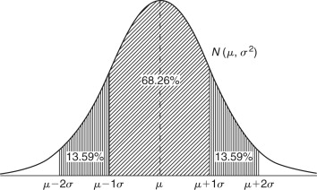



Encoder
Latent Space
Fully Connected Layer 1
Fully Connected Layer 2
Fully Connected Layer 3
Linear Output Log Variance
Linear Output Mean
ThicknessHeight Angle
+
Stiffness
Linear (32→3)
LeakyReLU
LeakyReLU
LeakyReLU
Linear (32→3)
Linear (4→64)
Linear (64→64)
Linear (64→32)
Decoder
Fully Connected Layer 4
Fully Connected Layer 5
Fully Connected Layer 6
Reparameterization
$$σ= \sqrt{e^{logvar}}$$
Z
+ Stiffness
LeakyReLU
LeakyReLU
LeakyReLU
Linear Output (64→3)
$$ε∽N(0,1)$$
Linear (4→32)
Linear (32→64)
Linear (64→64)
$$z=μ+σ∗ε$$

